Slide 1
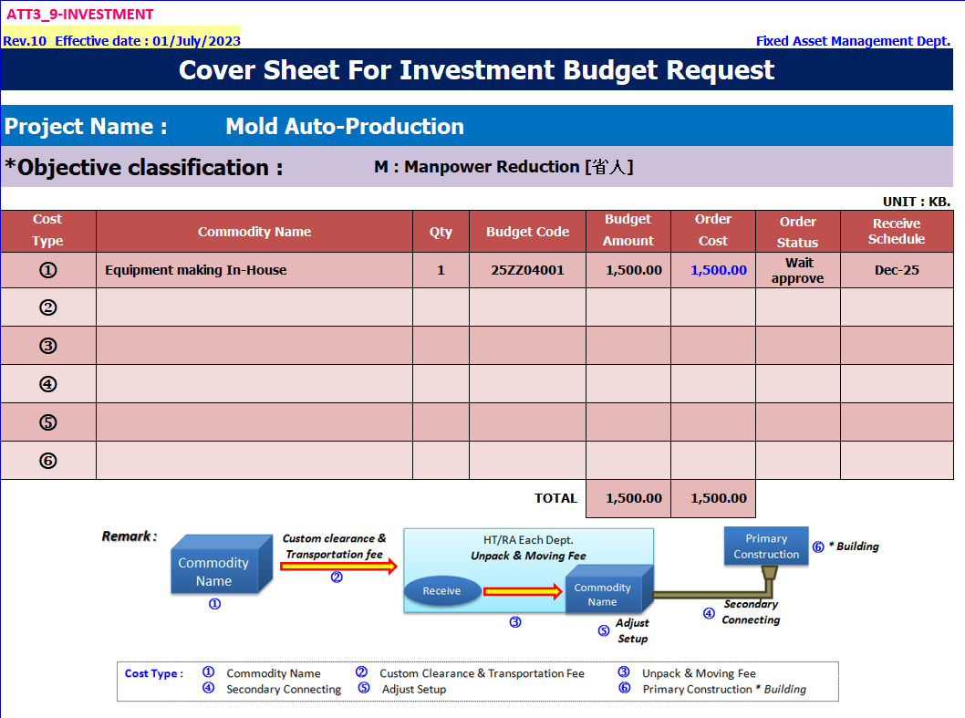
HT-MFG2 Mold Equipment Budget Request
1

Slide 2
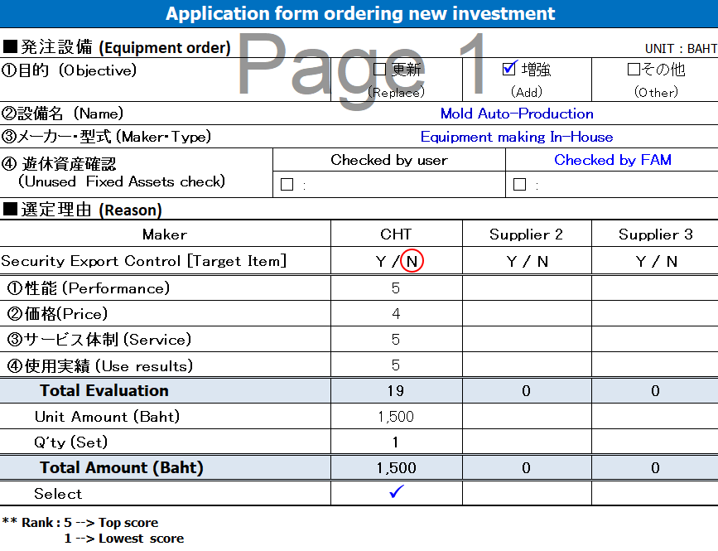
HT-MFG2 Mold Equipment Budget Request
2

Slide 3
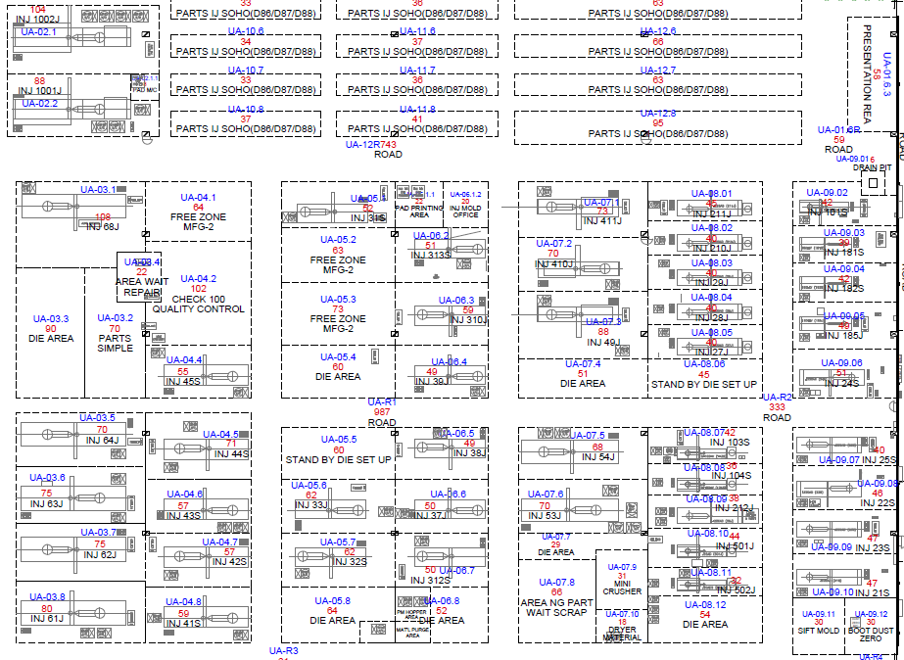


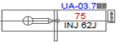
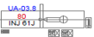
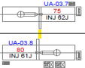
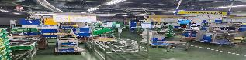
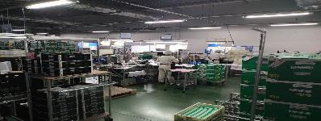
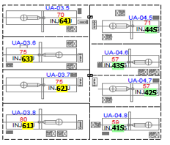
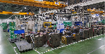
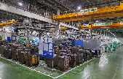
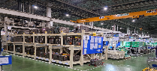
【 Ideal of MFG2 Full Automation Combine Cell】
❒ Layout Mold Production (06-Building)
1002J
MC Size Ton | Act. Oct'25 | Plan Jan’26 | Plan Apr’26 | Plan Jun’26
1000T | 2 | 2 | 2 | 2
650T | 5 | 7 | 9 | 9
550T | 2 | 5 | 7 | 7
450T | 8 | 8 | 8 | 8
350T | 9 | 9 | 9 | 6
220T | 10 | 10 | 10 | 8
180T | 3 | 3 | 3 | 3
100T | 3 | 3 | 3 | 3
102 (Gear) | 1 | 1 | 1 | 0
50T (Casset) | 2 | 2 | 2 | 1
184 (Gear) | 1 | 1 | 1 | 1
301 (Gear) | 1 | 1 | 1 | 1
TLL MC Use | 47 | 52 | 56 | 49
1001J
68J
J512
Store part
211J
Store part
411J
210J
J606
J513
410J
Cover Protect dust
29J
J607
J514
184N
49J
28J
MC Sell TLL=7MC
Mat’l auto loading
27J
MC Re-Lay out TLL=6MC
2nd PAD
2nd Screen
MP Line 06B | MC Total | Man Use | Die Space | 2nd Pad+Scr Space | 2nd Weld+ Check Space | KD Space
Line :1 | 10 | 8*2 | 362 | 89.8 | 119.2 | 32.0
Line :2 | 14 | 8*2
Line :3 | 11 | 7*2
Line :4 | 14 | 7*2
Total | 49 | 60 | M2 | TLL 2nd =241M2
J606
43S
301S
J608
45S
39J
J602
54m²
60m²
D
D
D
64J
R
103S
64J
44S
181S
38J
54J
R
44S
2
182S
104S
3
R
D
D
D
63J
33J
22S
63J
43S
43S
37J
53J
4
185J
D
D
D
R
R
101S
5
62J
32S
24S
62J
42S
313S
R
J516
1
42S
6
Merit: After MC Sell
& Re-lay out
➔Man Reduce=5Per.
➔Free Spec =331M²
501J
D
D
D
Die Keep area
Die Keep area
Move Shell Die Keep
21S
61J
41S
J515
Move Shell Die Keep
61J
41S
64m²
52m²
54m²
60m²

Slide 4
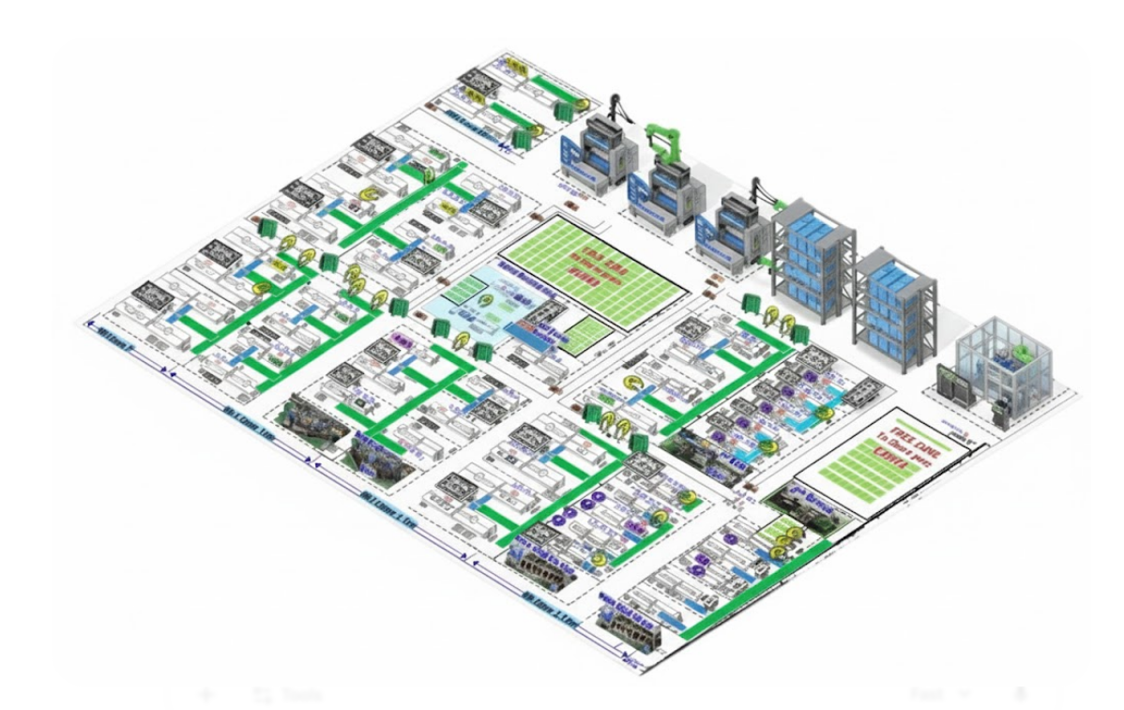
HT-MFG2 Mold Equipment Budget Request
4
【 Aru Beki Re-Lay out mold 06 building 】
Capacity MC JunY26 (49MC)
MC Size Ton | Act. Oct'25 | Plan Jan’26 | Plan Apr’26 | Plan Jun’26
1000T | 2 | 2 | 2 | 2
650T | 5 | 7 | 9 | 9
550T | 2 | 5 | 7 | 7
450T | 8 | 8 | 8 | 8
350T | 9 | 9 | 9 | 6
220T | 10 | 10 | 10 | 8
180T | 3 | 3 | 3 | 3
100T | 3 | 3 | 3 | 3
102 (Gear) | 1 | 1 | 1 | 0
50T (Casset) | 2 | 2 | 2 | 1
184 (Gear) | 1 | 1 | 1 | 1
301 (Gear) | 1 | 1 | 1 | 1
TLL MC Use | 47 | 52 | 56 | 49
Machine 1001J , 1002J
MC Sell TLL=7MC
MC Re-Lay out TLL=6MC
MP Line 06B | MC Total | Man Use | Die Space | 2nd Pad+Scr Space | 2nd Weld+ Check Space | KD Space
Line :1 | 10 | 8*2 | 362 | 89.8 | 119.2 | 32.0
Line :2 | 14 | 8*2
Line :3 | 11 | 7*2
Line :4 | 14 | 7*2
Total | 49 | 60 | M2 | TLL 2nd =241M2
Merit: After MC Sell
& Re-lay out
➔Man Reduce=5Per.
➔Free Spec =331M²

Slide 5
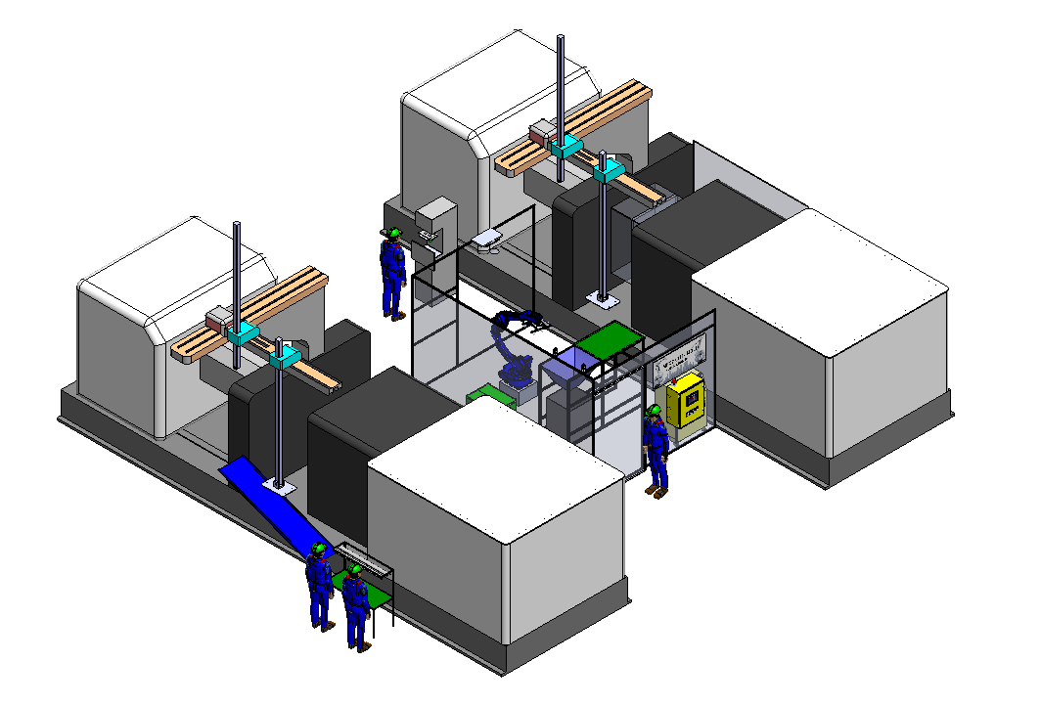
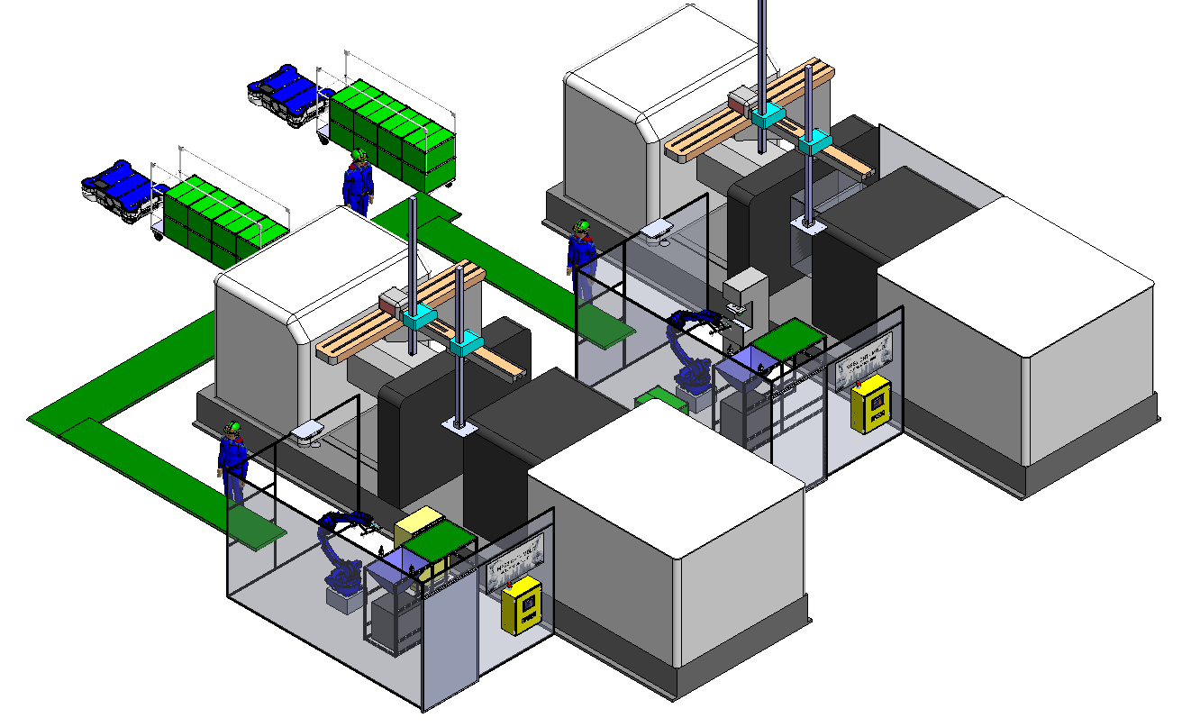
HT-MFG2 2nd Half Action Plan Review : Engineering
5
Full auto production combine cell
Target : Machine 1000 Ton (1001T , 1002T)
Current :
Improve : Automation
Add Conveyor
To combine
1001T & 1002T
Packing 1 P.
3
4
2
3
1
2
1
Automation
Set No.1
Support 2 Parts
Automation
Set No.1
Support 21 Parts
Add Automation
Set No.2
Support 29 Parts
 | Process MC | Work Process / Manpower |  |  |  |  |  |  | Manpower total
 |  | Cut gat | Pad Screen | Cut bari | Clean oil | ASSY part | Final check | Packing
Current | MC-1001T | 1 P. |  |  |  | 1 P. |  |  | 2 P. | 4 P.
 | MC-1002T | 1 P. |  |  |  | 1 P |  |  | 2 P.
After Improve | MC-1001T | Automation |  | 0.7 P. |  |  | Automation | 1 P. | 3 P.
 | MC-1002T | Automation |  | 0.7 P. |  |  | Automation
 |  |  |  | Katsu-JIN = 0.6 |  |  |  |  | Sho-JIN=1 P.
Summary Merit
Equipment Budget | 1,500 KB
Manpower Reduction | 1.6 P./Shift x 2 Shift = 3.2 Person
ROI | = 0.5 (23 month)

Slide 6
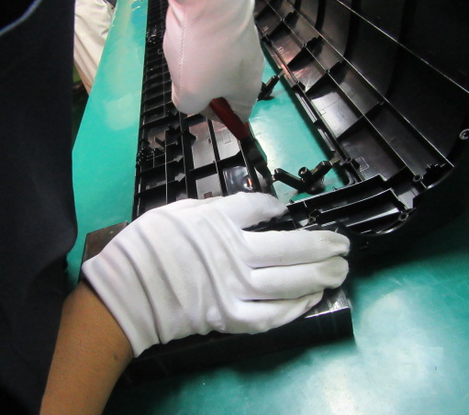
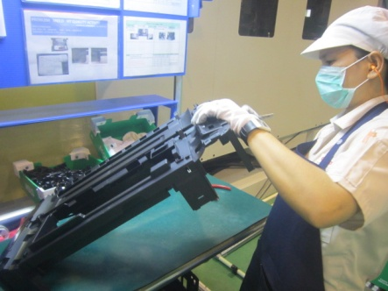
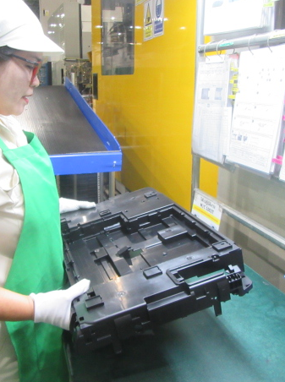
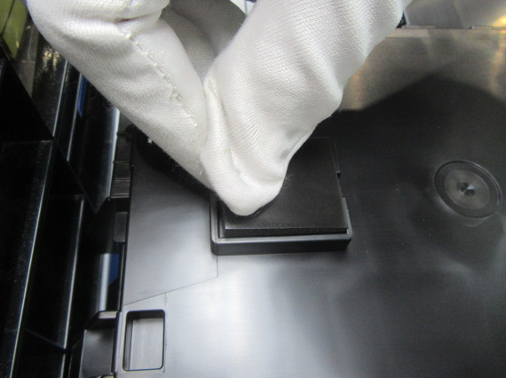
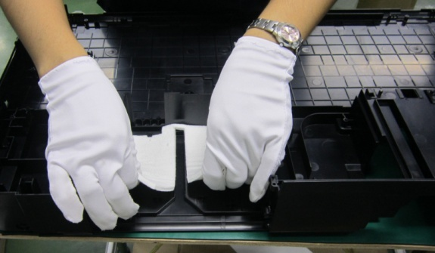
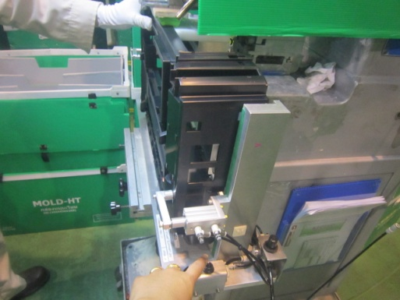
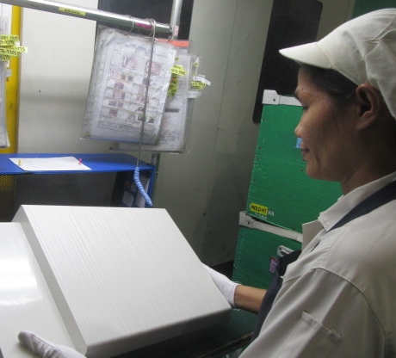
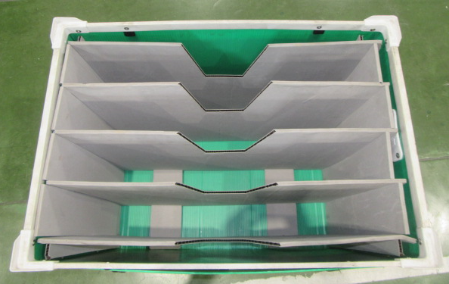
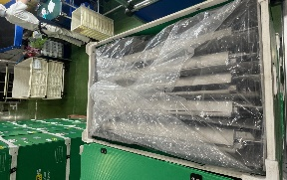
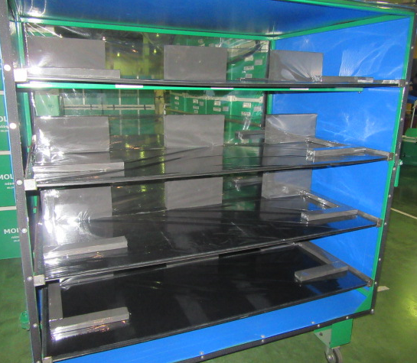
HT-MFG2 Mold Equipment Budget Request
6
❑ 1001T and 1002T Production Process & Manpower Workload
 | Total part list (Item part) | Production (part / day) | Manpower (Person)
MC 1001 | 21 | XX | 2
MC 1002 | 29 | XX | 2
 |  | Process
 |  | 1 | 2 | 3 | 4 | 5 | 6 | 7 | 8
 |  | Cut Gate | Cut Bari | Wipe off oil stains | Assembly Rubber Foot | Drain Sheet | PAD | Appearance Check | Packing (3 Type)
 |  |  |  |  |  |  |  |  | Box | Box + Bage | Rack
MC 1001 | Man1 |  |  |  | 
 | Man2 |  |  |  |  |  |  |  |  |  | 
MC 1002 | Man3 |  |  |  |  |  |  |  |  |  | 
 | Man4 |  |  |  |  |  |  | 
After |  | Automation -Robot | Man | Man | Automation -Robot | Man | Automation -Robot | Automation -Robot -Camera | Man | Man | Man
 |  |  |  |  |  |  |  |  | Conveyor Combine 1001T + 1002T

Slide 7
HT-MFG2 Mold Equipment Budget Request
7
 Workload Balance & Manpower Sho-JIN / Katsu-JIN
Unit : Process
(Sho-Jin Manpower 4 = 1 by Mold Auto production)
Unit : Process
( Auto production)

Slide 8
HT-MFG2 Mold Equipment Budget Request
8
Project Name : Mold Auto-Production
 Concept manpower and machine Size 1000 Ton
 Process Machine 1000 Ton
Condition : O =Yes X = No
-Auto AGV
Man-3
Man-1
Summary Process machine 1000Ton after “Mold Auto-Production”
Process | Cutting gate | Cut Bari | Cleaning Oil | PAD Printing | Assembly Rubber Foot | Drain Sheet | Appearance Check | Packing
Man1 | O | O | O | X | X | X | X | X
Man2 | O | O | O | X | X | O | X | X
Man3 | X | X | X | X | X | X | X | O
Robot | O | X | X | O | O | X | O | X
Camera | O | X | X | O | X | X | O | X
-Auto Camera CHK
-Auto-Cutting Gate
-Auto PAD
3.Add Conveyor u.
Combine
2 MC.
-Auto Camera CHK
-Auto-Cutting Gate
-Auto PAD
Man-2
1.Modify Auto Set #1.
to cover all part
 Number of working processes of machines and man
2.Add Auto Set #2.
(Sho-Jin Manpower 4 = 1 by Mold Auto production)
Unit : Process
( Auto production)
Detail change point
1.Modify Auto Set #1.to cover all part
2.Add Auto Set #2.
3.Add Conveyor u Combine 2 MC.

Slide 9
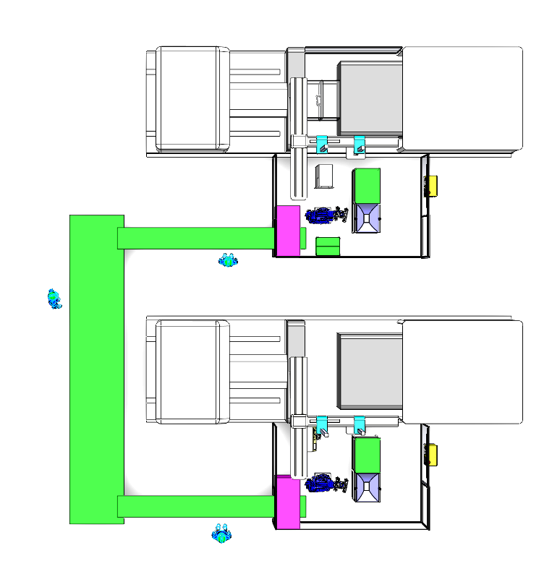
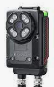
HT-MFG2 Mold Equipment Budget Request
9
Project Name : Mold Auto-Production
 Detail Automation Concept
5
4
3
2
1
Operator Packing
Operator Confirm Part
CAMERA CHECK
Part Have Process PAD Robot Move To PAD
Robot Move Cutting Gate Part
3.Operator for Packing Part To Box and Control AGV Auto To Store Part
1001J
2.PAD
1.Auto Cut Gate
3.CAMERA CHECK
AGV
ROBOT
1.Operator Confirm Part
AGV
1002J
1.Auto Cut Gate
2.CAMERA CHECK
2.Operator Confirm Part
ROBOT
(Wait Transfer Form CHT-RA)
4
3
2
1
Operator Packing
Operator Confirm Part
CAMERA CHECK
Robot Move Cutting Gate Part

Slide 10
HT-MFG2 Mold Equipment Budget Request
10
Project Name : Mold Auto-Production
 Detail Automation Concept
5
4
3
2
1
Operator Packing
Operator Confirm Part
CAMERA CHECK
Part Have Process PAD Robot Move To PAD
Robot Move Cutting Gate Part
3.Operator for Packing Part To Box and Control AGV Auto To Store Part
Gate Cutting
PAD/Screen
Appearance Check
1001J
AGV
1.Operator Confirm Part
AGV
1002J
1.Auto Cut Gate
2.CAMERA CHECK
2.Operator Confirm Part
ROBOT
(Wait Transfer Form CHT-RA)
4
3
2
1
Operator Packing
Operator Confirm Part
CAMERA CHECK
Robot Move Cutting Gate Part

Slide 11
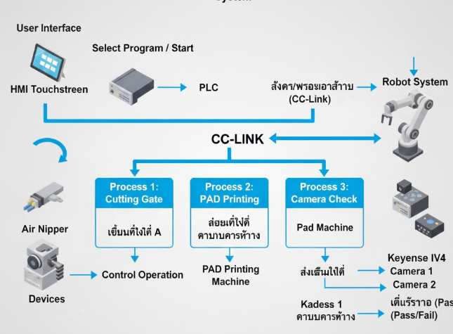

HT-MFG2 Mold Equipment Budget Request
11
Flow การทำงาน
เลือกและ Start: ผู้ใช้เลือกคำสั่งบนจอ HMI แล้วกด Start
PLC สั่ง Robot: PLC รับคำสั่งและส่งไปให้ Robot
Robot ทำงานทีละ Process:
- ตัด Gate: Robot ไปที่จุดตัด, สั่ง Air Nipper ตัด
- Pad: Robot ไปที่จุด PAD , สั่งเครื่อง Pad
- ตรวจสอบ: Robot ไปที่จุดตรวจสอบ, สั่งกล้อง IV4 ทั้งสองตัวตรวจสอบ
Robot รายงานผล: Robot ส่งผลการทำงานแต่ละขั้นกลับไปที่ PLC
PLC อัปเดต HMI: PLC แจ้งสถานะการทำงานทั้งหมดกลับไปที่ HMI
ทั้งหมดนี้จะสื่อสารกันผ่านระบบ CC-Link เพื่อให้ข้อมูลไหลเวียนได้อย่างรวดเร็วและมีประสิทธิภาพ
Gate
PAD
CHECK
New Concept
Send
CC-Link

Slide 12
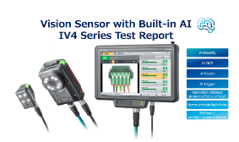
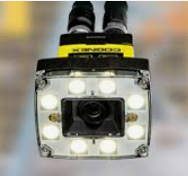
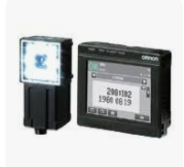

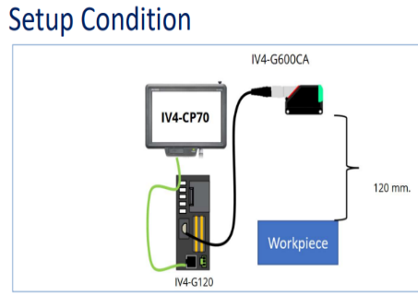
HT-MFG2 Mold Equipment Budget Request
12
2.Camera Unit
Vision Sensor Industry Comparison Table (IV4 Series)
No. | KEYENCE IV4 Series | Cognex In-Sight 2000 Series (Closest Competitor) | Omron FQ2 Series (Alternative Competitor)
Main Product Type | Vision Sensor (with built-in AI) | Vision Sensor / Smart Camera | Vision Sensor
Key Technology | AI Accelerator Chip and Built-in Deep Learning/AI | Rule-based Vision Tools (Pattern, Edge, Blob) | Rule-based and Algorithmic Vision Tools
Resolution | Approx. 1.2 MP (1/2.9 inch CMOS) | Up to 1.3 MP | Up to 1.3 MP
Processing Speed | Up to 250 parts/sec (4 ms.) for AI judgment | Medium to High (depending on tool complexity) | Medium to High
Installation | All-in-one (Camera, Lens, Lighting) | All-in-one (Camera, Lens, Lighting) | All-in-one (Camera, Lens, Lighting)
Ease of Setup | Very Easy (Uses only a few sample images to train AI, no position adjustment needed) | Easy (Uses Spreadsheet Interface/GUI) | Easy to use with HMI or PC Software
IV4 Strengths | High inspection stability, even with slight variations in workpiece position or surface (AI Differentiate, AI Identify) | Features highly accurate vision tools (Padma Redline) and has a wide industrial customer base | Highly reliable in production lines and easily connects to Omron PLCs
Price Level (Estimated) | High (Premium, focused on AI innovation and simplicity) | Medium to High (depending on sub-model) | Medium to High

Slide 13
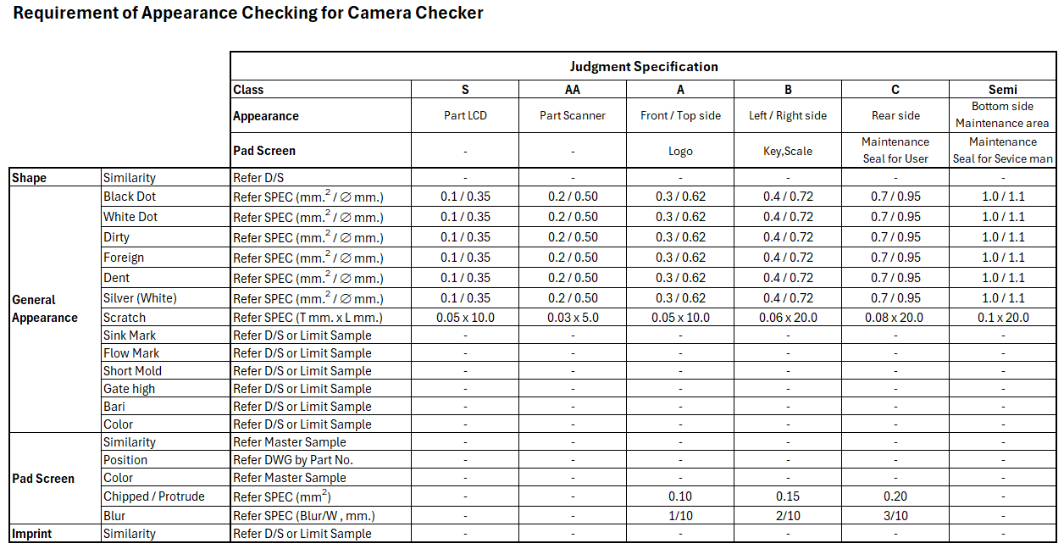
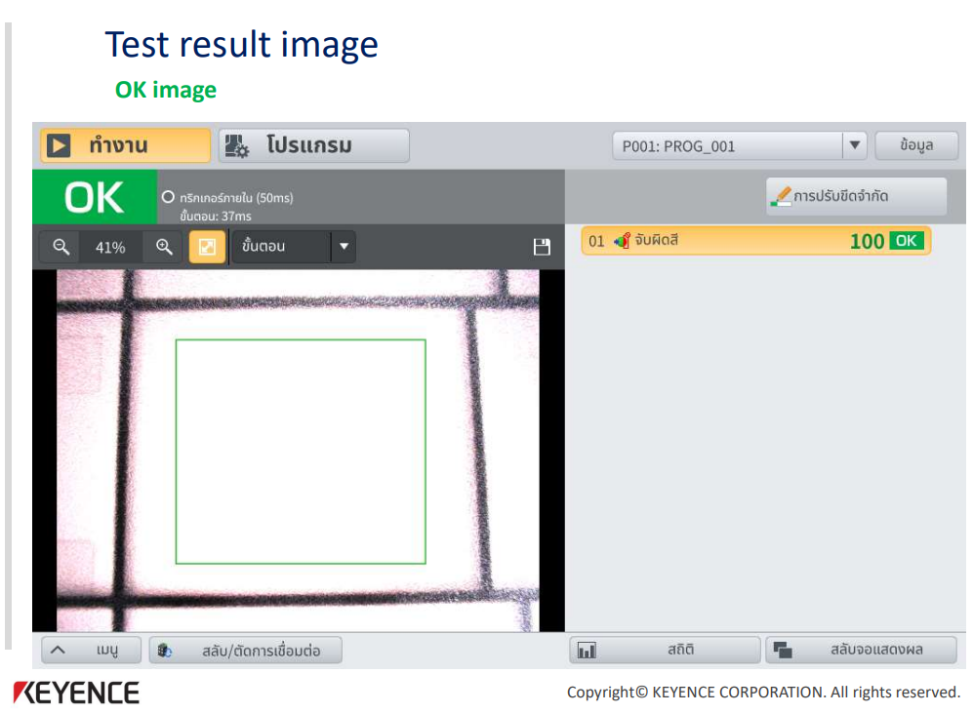
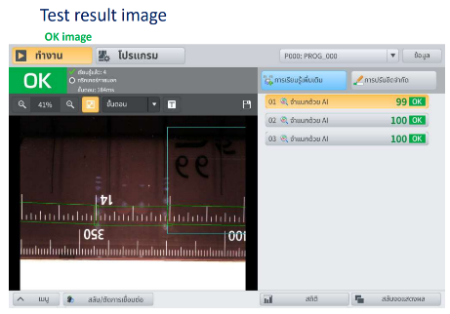
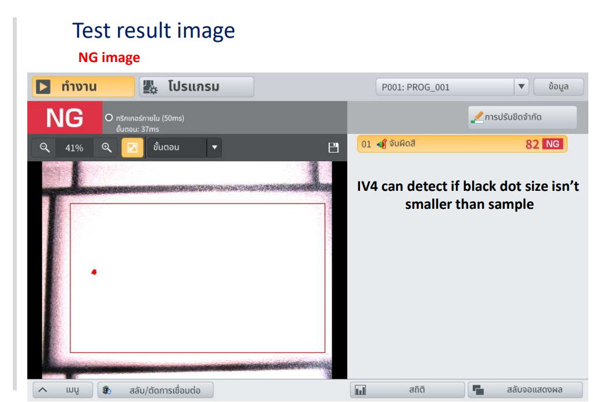
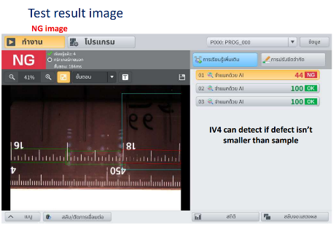
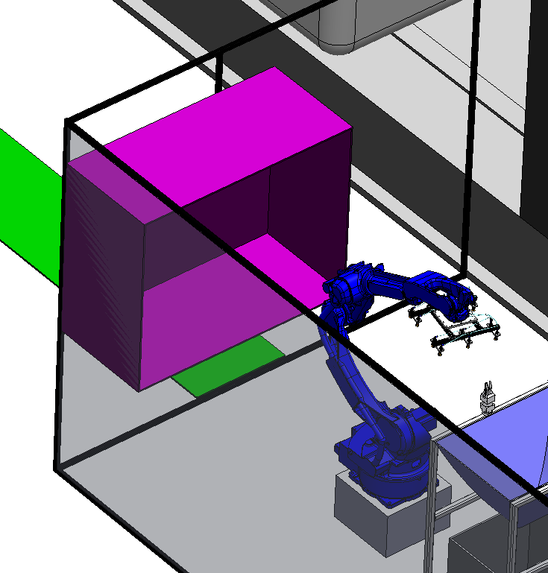
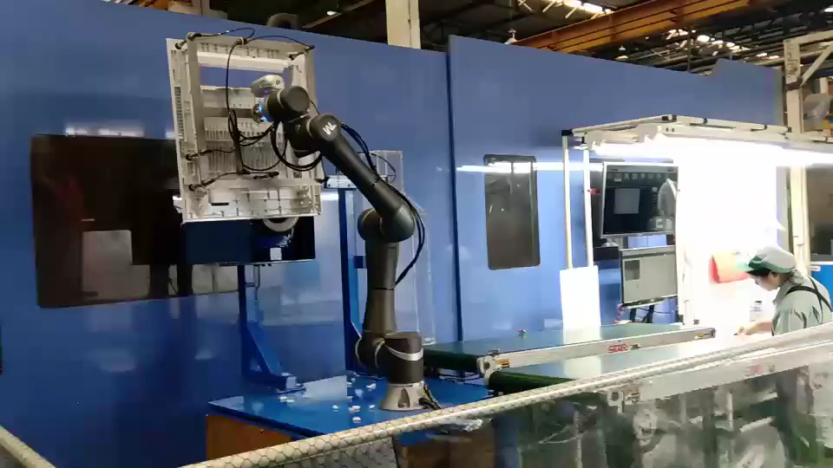
HT-MFG2 Mold Equipment Budget Request
13
2.Camera Unit
Black Dot
Check Confirm PAD
2. Camera Unit
Equipment Name |  | Estimate Cost (KB.)
 |  | Cost | Q’TY | Total Cost
1 | Camera (IV 4 KEYENCE) | 110 | 3 | 330
2 | Structure and Cover | 30 | 1 | 30
Total Cost |  |  |  | 360
Box Camera
Concept Robot Move part use Camera check

Slide 14
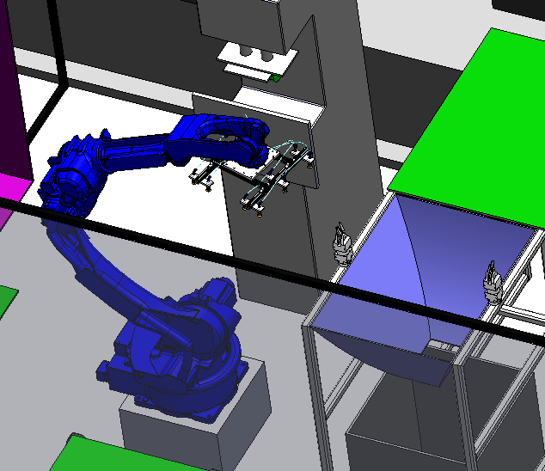
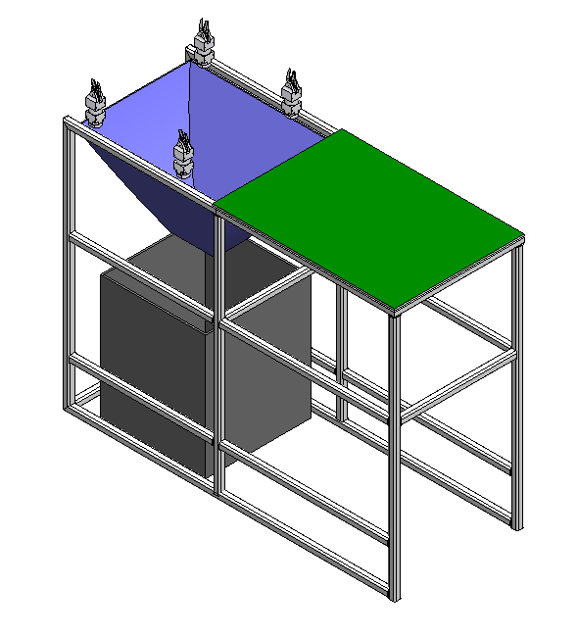
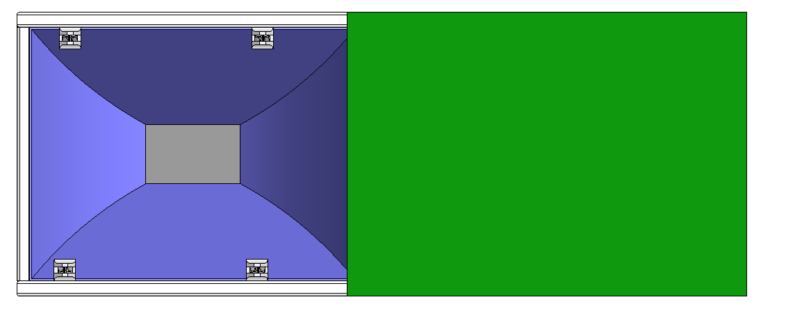
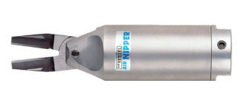
HT-MFG2 Mold Equipment Budget Request
14
1.Automation Cut Gate
Step of Automation Cut Gate
Robot of machine injection input Part at table automation cut gate
Robot 7 axis move part to Auto Nipper at position gate at part
Function
Estimate Time = 5-10 Sec.
1. Auto Cutting Unit
Equipment Name |  | Estimate Cost (KB.)
 |  | Cost | Q’TY | Total Cost
1 | Air Nipper | 20 | 2 | 40
2 | Sensor Check | 15 | 2 | 30
3 | Solenoid Valve | 3 | 3 | 9
4 | Structure and Cover | 11 | 1 | 11
Total Cost |  |  |  | 90
Injection Machine
PART
PART
Jig Move Air Nipper depend on Shape part on
ROBOT

Slide 15
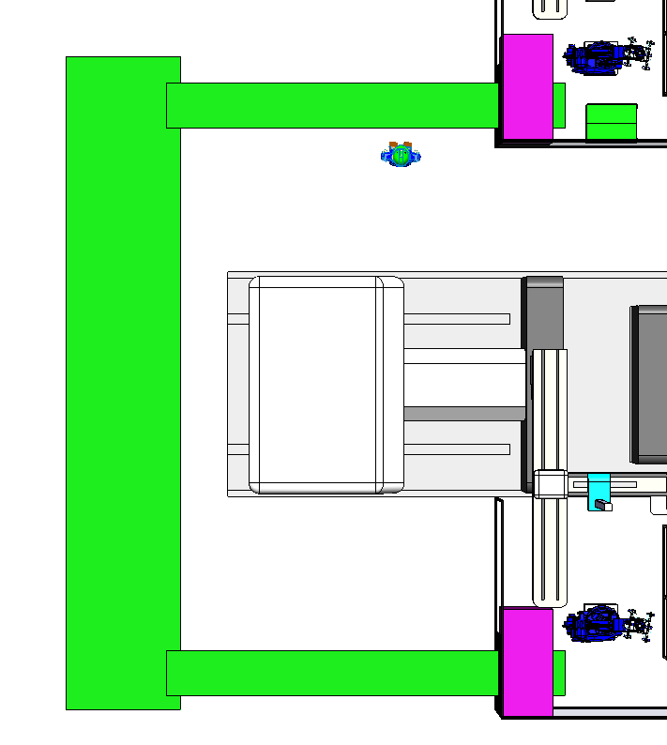
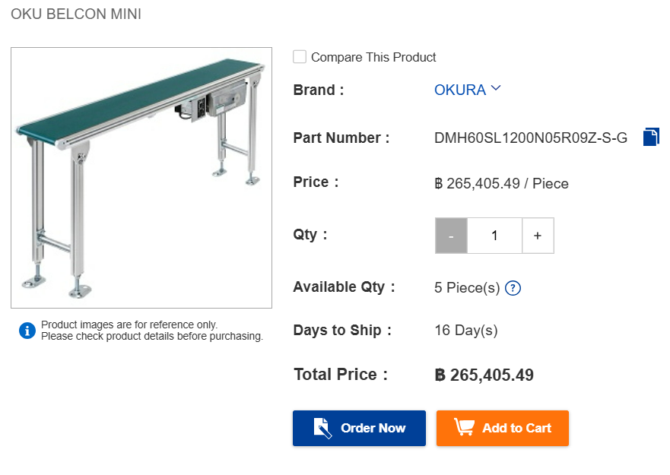
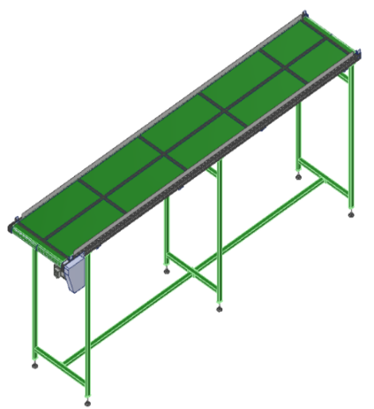
HT-MFG2 Mold Equipment Budget Request
15
Conveyor Unit
 Concept 1 .Ready-made order.
 Detail Conveyor
Unit Price (In case of order)
1.5 M
Length 5.5 M
Unit Price : 1 set length 1.2 meters price 265,405 baht
0.7 M
Check price from Misumi
 Concept 2. Ordering some parts.
Conveyor
Length 9.5 M
Detail order part Conveyor Unit
Equipment Name |  | Estimate Cost (KB.)
 |  | Cost | Q’TY | Total Cost
1 | AC Motor | 5 | 4 | 20
2 | Belt Conveyor | 10 | 4 | 40
3 | Structure Conveyor | 20 | 1 | 20
Total Cost |  |  |  | 80
Roller
Belt
Aluminum Profile
Length 5.5 M
Motor
Assembly By CHT-MOLD
0.7 M
● 1 set of Estimate Cost 80,000 baht
“Select Concept 2 of buying some parts to assemble internally to reduce costs”.

Slide 16
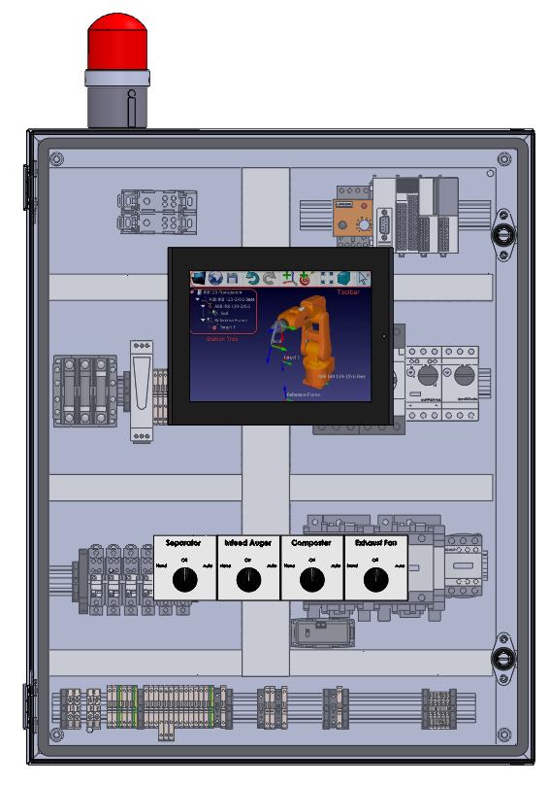
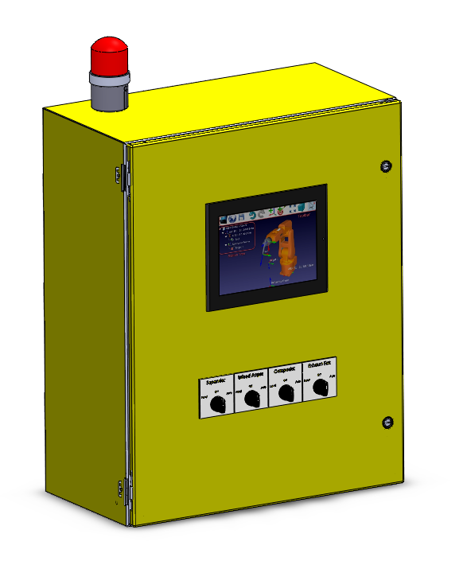
HT-MFG2 Mold Equipment Budget Request
16
Electrical Equipment Unit
4. Electrical Equipment
Equipment Name |  | Estimate Cost (KB.)
 |  | Cost | Q’TY | Total Cost
1 | Box Control | 13 | 1 | 13
2 | PLC MELSEC-F FX3S | 40 | 1 | 40
3 | GOT2000 Series GT21 | 27 | 1 | 27
4 | Power Support | 10 | 1 | 10
Total Cost |  |  |  | 90

Slide 17
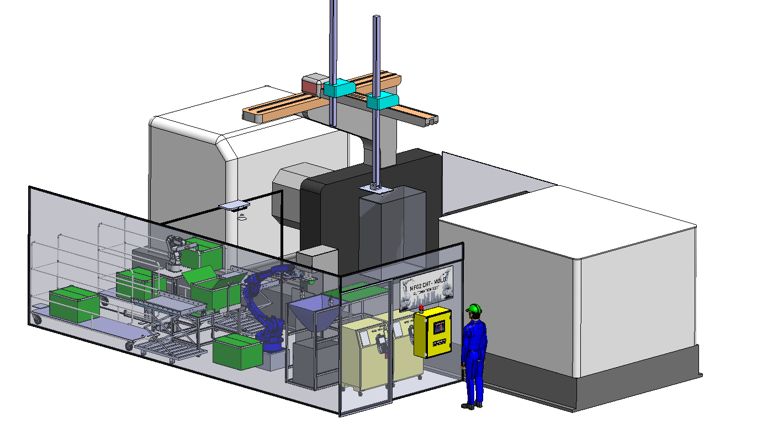
HT-MFG2 Mold Equipment Budget Request
17
Detail : Equipment for Unit in Projection Auto Production Step 2
1. Auto Cutting Unit
Equipment Name |  | Estimate Cost (KB.)
 |  | Cost | Q’TY | Total Cost
1 | Air Nipper | 20 | 2 | 40
2 | Sensor Check | 15 | 2 | 30
3 | Solenoid Valve | 3 | 3 | 9
4 | Structure and Cover | 11 | 1 | 11
Total Cost |  |  |  | 90
4. Electrical Equipment
Equipment Name |  | Estimate Cost (KB.)
 |  | Cost | Q’TY | Total Cost
1 | Box Control | 13 | 1 | 13
2 | PLC MELSEC-F FX3S | 40 | 1 | 40
3 | GOT2000 Series GT21 | 27 | 1 | 27
4 | Power Support | 10 | 1 | 10
Total Cost |  |  |  | 90
Man-3
Man-1
-Auto Camera CHK
-Auto AGV
-Auto-Cutting Gate
-Auto PAD
Man-2
3.Add Conveyor u.
Combine
2 MC.
-Auto-Cutting Gate
-Auto PAD
2. Camera Unit
Equipment Name |  | Estimate Cost (KB.)
 |  | Cost | Q’TY | Total Cost
1 | Camera (IV 4 KEYENCE) | 110 | 3 | 330
2 | Structure and Cover | 30 | 1 | 30
Total Cost |  |  |  | 360
5. Cover Unit
Equipment Name |  | Estimate Cost (KB.)
 |  | Cost | Q’TY | Total Cost
1 | Area Sensor | 40 | 1 | 40
2 | Structure and Cover | 20 | 1 | 20
Total Cost |  |  |  | 60
-Auto Camera CHK
1.Modify Auto Set #1.
to cover all part
2.Add Auto Set #2.
Detail Show Cost for Unit by Unit
Sum Detail Unit for 1 Machine Cost = 720 KB.
For Project Auto Production use 2 Machine Cost =1440 KB.
3. Conveyor Unit
Equipment Name |  | Estimate Cost (KB.)
 |  | Cost | Q’TY | Total Cost
1 | AC Motor | 5 | 4 | 20
2 | Belt Conveyor | 10 | 4 | 40
3 | Structure Conveyor | 20 | 1 | 20
Total Cost |  |  |  | 80
6. Gripper Robot
Equipment Name |  | Estimate Cost (KB.)
 |  | Cost | Q’TY | Total Cost
1 | Cylinder Gipper | 35 | 1 | 35
2 | Structure and Cover | 5 | 1 | 5
Total Cost |  |  |  | 40
■ Estimate ROI
1,440 KB. / 3.2 P. x 235 KB. = 1.95 Year (23months)
Conveyor Unit
Conveyor Unit
Camera Unit
Robot
2.Auto-PAD Printing
3.Auto-Appearance CHK by Camera
4.Auto-Packing by Robot
1.Auto-Cutting Gate
Notes:
เนื่องจากในปีนี้ ทางMFG2 Mold มีแผนการทำProject Full Auto Production
โดยมีเป้าหมายที่เครื่องฉีด1001T
มีProcessการทำงานหลัก 4 ขั้นตอน
Cutting Gate
PAD Printing
Appearance Check
Packing

Slide 18
Appendix

Slide 19
HT-MFG2 Mold Equipment Budget Request
19
ASSETS | OBJ. | BUDGET CODE | BUDGET NAME | W.C. | BUDGET (KB.) | ORDER
04 | 30 | 25ZZ04001 | Automation New | 3601 | 1,500 | 10/2025
■ Estimate Cost
Equipment Name |  | Estimate Cost (KB.)
 |  | Cost / u. | Q’TY | Total Cost
1 | Auto Cutting Unit | 90 | 2 | 180
2 | Camera Check Unit | 300 | 2 | 600
3 | Conveyor Unit | 80 | 2 | 160
4 | Electrical Equipment | 90 | 2 | 180
5 | Cover Unit | 60 | 2 | 120
6 | Gripper Robot | 40 | 2 | 80
Total Cost |  |  |  | 1,440
Project Name : Mold Auto-Production , Purpose : Cost Down (Sho-JIN / Ktsu-JIN)
Before
-Auto PAD
-Auto Camera CHK
Man-2
-Auto-Cutting Gate
Man-1
■ Ktasu-JIN , Sho-Jin
Process |  | Manpower (Person / Shift)
 |  | Before |  | After
 |  | 1001T | 1002T | 1001T | 1002T
1 | Cutting Gate | 1 | 1 | 0.7 Katsu-JIN =0.3 | 0.7 Katsu-JIN =0.3
2 | Cut Bari
3 | Cleaning Oil
4 | PAD Printing | 1 | 1
5 | Appearance Check |  |  | 1 (Sho-Jin = 1)
6 | Packing
Total |  | 4 |  | 1.4
Reduce Manpower = 1.6 Person / Shift Total 2 Shift = 3.2 Person
Man-4
Man-3
Auto Set #1.
Support production 2 parts
After
Man-3
-Auto AGV
Man-1
-Auto Camera CHK
-Auto-Cutting Gate
-Auto PAD
Man-2
3.Add Conveyor u.
Combine
2 MC.
-Auto-Cutting Gate
-Auto PAD
-Auto Camera CHK
1.Modify Auto Set #1.
to cover all part
■ Estimate ROI
1,440 KB. / 3.2 P. x 235 KB. = 1.95 Year (23months)
2.Add Auto Set #2.
Notes:
เนื่องจากในปีนี้ ทางMFG2 Mold มีแผนการทำProject Full Auto Production
โดยมีเป้าหมายที่เครื่องฉีด1001T
มีProcessการทำงานหลัก 4 ขั้นตอน
Cutting Gate
PAD Printing
Appearance Check
Packing

Slide 20
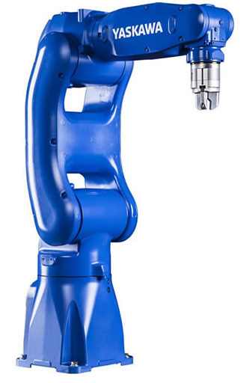

HT-MFG2 Mold Equipment Budget Request
20
Part Injection 1001T and 1002T
Compare Process for New Process Add Robot
Process Part All 10 Process
Cutting gate | Wipe off oil stains | Cut Bari | BOX | Box (มีถุงด้านใน) | Assembly Rubber Foot | Drain Sheet | PAD | Rack | Confirm Part
New Process (ROBOT / OPERATOR)
Camera
Camera
Camera

Slide 21
ยกตัวอย่างการการปรับปรุง 1 Case
เลือก Partที่มีMeritสูง QC5-6187 / QC91451
Picture
Before
After
Process Before
Time chart Before
Process After
Time chart Before
Conclude Merit

Slide 22
Appearance Check Require.. |  | Ability of Camera
Check Item | Judge Method
 | Spec XXX
 | D/S , Limit Sample
ตัวอย่างจุดตรวจสอบยาก และปัญหาการตรวจสอบหรุดรอด
การรองรับด้วยCamera check

Slide 23
HT-MFG2 Mold Equipment Budget Request
23
Full auto Production Step 2
Action Plan / Schedule
Action plan process |  | 2025 |  |  |  |  | 2026
 |  | Aug | Sep | Oct | Nov | Dec | Jan | Feb | Mar | Apr | May | Jun | Jul
Design 3D | Plan
 | Actual
Request Equipment Budget | Plan
 | Actual
Order part | Plan
 | Actual
Making | Plan
 | Actual
Debug | Plan
 | Actual
Input MP | Plan
 | Actual
Notes:
Action plan

Slide 24
HT-MFG2 Mold Equipment Budget Request
24
แยกข้อมูลแต่ละUnitให้เข้าใจถึงการออกแบบ การทำงาน ความสามารถ และEquipmentที่ต้องการ (ทุก Unit)
Camera Check Concept.
1. Appearance Guarantee Items / Spec.
3. Camera check design concept
2. Equipment SPEC Requirement
4. Equipment cost / order preparation
-Quotation …
2. Camera Unit
Equipment Name |  | Estimate Cost (KB.)
 |  | Cost | Q’TY | Total Cost
1 | Camera (IV 4 KEYENCE) | 110 | 3 | 330
2 | Structure and Cover | 30 | 1 | 30
Total Cost |  |  |  | 360

Slide 25
HT-MFG2 Mold Equipment Budget Request
25
ทำFlowให้เข้าใจเส้นทางของPartและการทำงานของเครื่อง คน Robot
Automation Concept.
Auto PAD
Camera
Robot
Auto
Cut
gate
CTRL Box

Slide 26
HT-MFG2 Mold Equipment Budget Request
26
Automation Concept.
Before
After
5
4
3
2
1
Operator Packing
Operator Confirm Part
CAMERA CHECK
Part Have Process PAD Robot Move To PAD
Robot Move Cutting Gate Part
Operator for Packing Part To Box and Control AGV Auto To Store Part
1001J
2
2.PAD
1.Auto Cut Gate
1001 J
3.CAMERA CHECK
1
AGV
4.Operator Confirm Part
ROBOT
1002 J
AGV
1002J
3
1.Auto Cut Gate
4
2.CAMERA CHECK
3.Operator Confirm Part
ROBOT
(Wait Transfer Form CHT-RA)
4
3
2
1
Operator Packing
Operator Confirm Part
CAMERA CHECK
Robot Move Cutting Gate Part

Slide 27
HT-MFG2 Mold Equipment Budget Request
27
แยกข้อมูลแต่ละUnitให้เข้าใจถึงการออกแบบ การทำงาน ความสามารถ และEquipmentที่ต้องการ (ทุก Unit)
Camera Check Concept.
1. Appearance Guarantee Items / Spec.
3. Camera check design concept
2. Equipment SPEC Requirement
4. Equipment cost / order preparation
-Quotation …
2. Camera Unit
Equipment Name |  | Estimate Cost (KB.)
 |  | Cost | Q’TY | Total Cost
1 | Camera (IV 4 KEYENCE) | 110 | 3 | 330
2 | Structure and Cover | 30 | 1 | 30
Total Cost |  |  |  | 360

Slide 28
 |  |  |  |  | Planner | Production | Qa
No | M / C | Mold Master | Part no |  | Lot size | Man power | Point bari
1 | 1001J | QC8-1089 |  |  | 1 | 1 | 0
2 | 1001J | QC8-1090 |  |  | 2 | 1 | 0
3 | 1001J | QC8-1084 |  |  | 1 | 1 | 2
4 | 1001J | QC8-1086 |  |  | 1 | 1 | 1 (ใย Bari)
5 | 1001J | QC4-7500 |  |  | 1 | 2 | 0
6 | 1001J | QC4-7542 |  |  | 1 | 2 | 0
7 | 1001J | QC6-6991 | QL3-1513(ประกอบdrain sheet&Ruber foot) |  | 1 | 1 | 1
8 | 1001J | QC5-2640 | QC8-5521(change mat'l) |  | 4 | 1 | 1
9 | 1001J | QC5-2678 | QC8-5533 | QM4-4536 | 4 | 1 | 0
10 | 1001J | QC5-6187 | QC9-4151 |  | 5 | 1 | 0
11 | 1001J | QD1-2374 | QC8-2613 | QC7-5940 | 5 | 2 | 4
12 | 1001J | QD1-2375 | QC8-2614 | QC7-5951 | 5 | 2 | 5
13 | 1001J | QD1-2358 | QC8-2547 |  | 3 | 1 | 3
14 | 1001J | QD1-2366 | QC8-2578 |  | 3 | 1 | 0
15 | 1001J | QC5-6174 |  |  | 7 | 2 | 0
16 | 1001J | QC5-9312 |  |  | 30 | 1 | 0
17 | 1001J | QC5-9313 |  |  | 30 | 1 | 0
18 | 1001J | QC5-9301 |  |  | 30 | 1 | 0
19 | 1001J | QC5-9302 |  |  | 30 | 1 | 0
20 | 1002J | FE2-P911 |  |  | 1 | 2 | 14
21 | 1002J | FE3-6799 |  |  | 2 | 2 | 9
22 | 1002J | FE3-K645 |  |  | 15 | 2 | 0
23 | 1002J | FE3-L985 |  |  | 15 | 2 | 0
24 | 1002J | FE2-L238 |  |  | 3 | 2 | 1
25 | 1002J | FE3-7438 |  |  | 3 | 2 | 3
26 | 1002J | FE2-N591 | FL1-H130 |  | 5 | 2 | 9
27 | 1002J | FE2-L230 | FL1-A133 |  | 5 | 2 | 0
28 | 1002J | QC8-4391 | QC8-1084(change mat'l) |  | 15 | 2 | 2
29 | 1002J | QC8-4393 | QC8-1086(change mat'l) |  | 15 | 2 | 1
30 | 1002J | FE2-M001/M002 |  |  | 5 | 2 | 0/0
31 | 1002J | QC8-1080 |  |  | 1 | 2 | 0
32 | 1002J | QC8-1152 |  |  | 1 | 2 | 3
33 | 1002J | QC8-1153 |  |  | 2 | 2 | 2 (ใย bari)
34 | 1002J | QC4-9176 | QC8-1270(change mat'l) |  | 30 | 2 | 0
35 | 1002J | QC4-9447 | QC8-1271(change mat'l) |  | 30 | 2 | 0
36 | 1002J | QC5-9299 | QC7-5885 (Change Mat’l) |  | 30 | 2 | 0
37 | 1002J | QC5-9300 | QC7-5886(change mat'l) |  | 30 | 2 | 0
38 | 1002J | QC5-9296 | QC7-5891(change mat'l) |  | 30 | 2 | 0
Lot Size
1 = Run ทุกวัน
2 = วันเว้นวัน
3 = 3 Run 1 ครั้ง
4 = 4 Run 1 ครั้ง
5 = 5 Run 1 ครั้ง
7 = 7 Run 1 ครั้ง
15 = 4 Run 1 ครั้ง
30 = 4 Run 1 ครั้ง

Slide 29

HT-MFG2 Mold Equipment Budget Request
29
Summary Process Time of 1001T , 1002T
Detail Compare Time Operator at Cannot use Robot

